Slide 1

Using Python to
generate emoji-style images
20/21: Coding Two: Advanced Frameworks
Final Project
CHANG WANG 20036997
Github: https://github.com/changw1006/ual-cci-term2-coding2-Final-Project

Slide 2
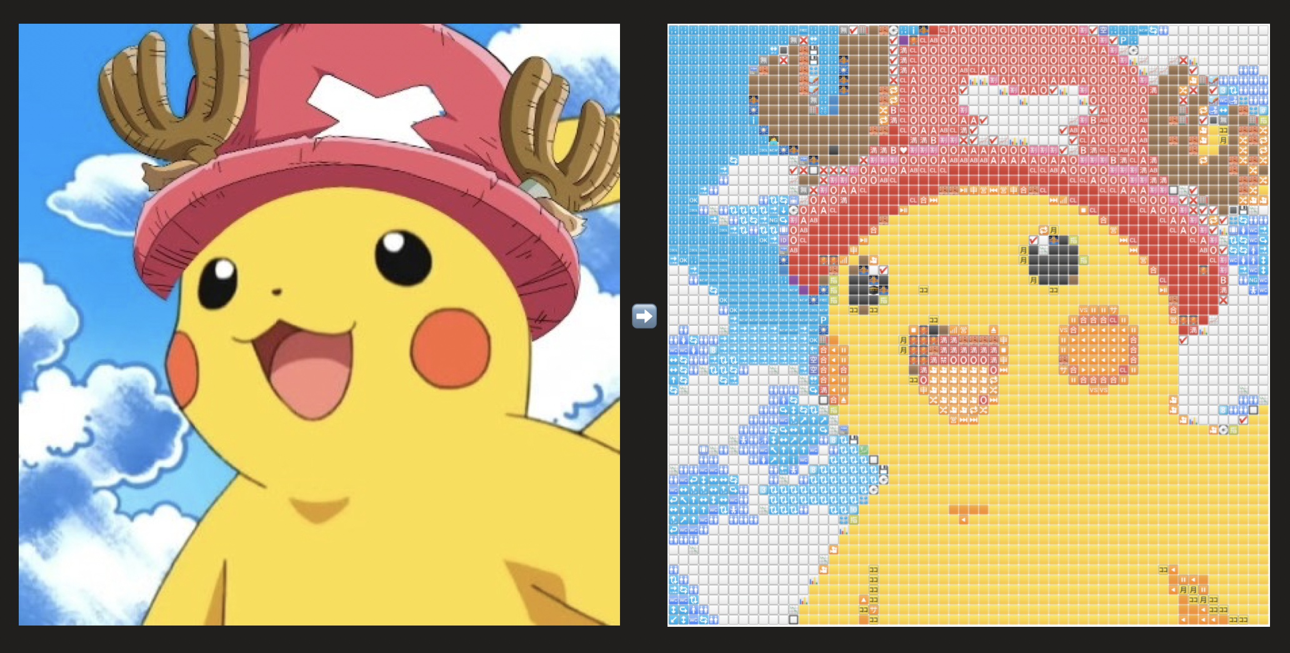
1 BRIEF
Using Python to generate
emoji-style images
One day I was chatting with my friend on an app, and while using emojis, I noticed that emojis are very colourful, what would be the effect if a picture was made up of emojis? So that's how I came up with this project.

Slide 3
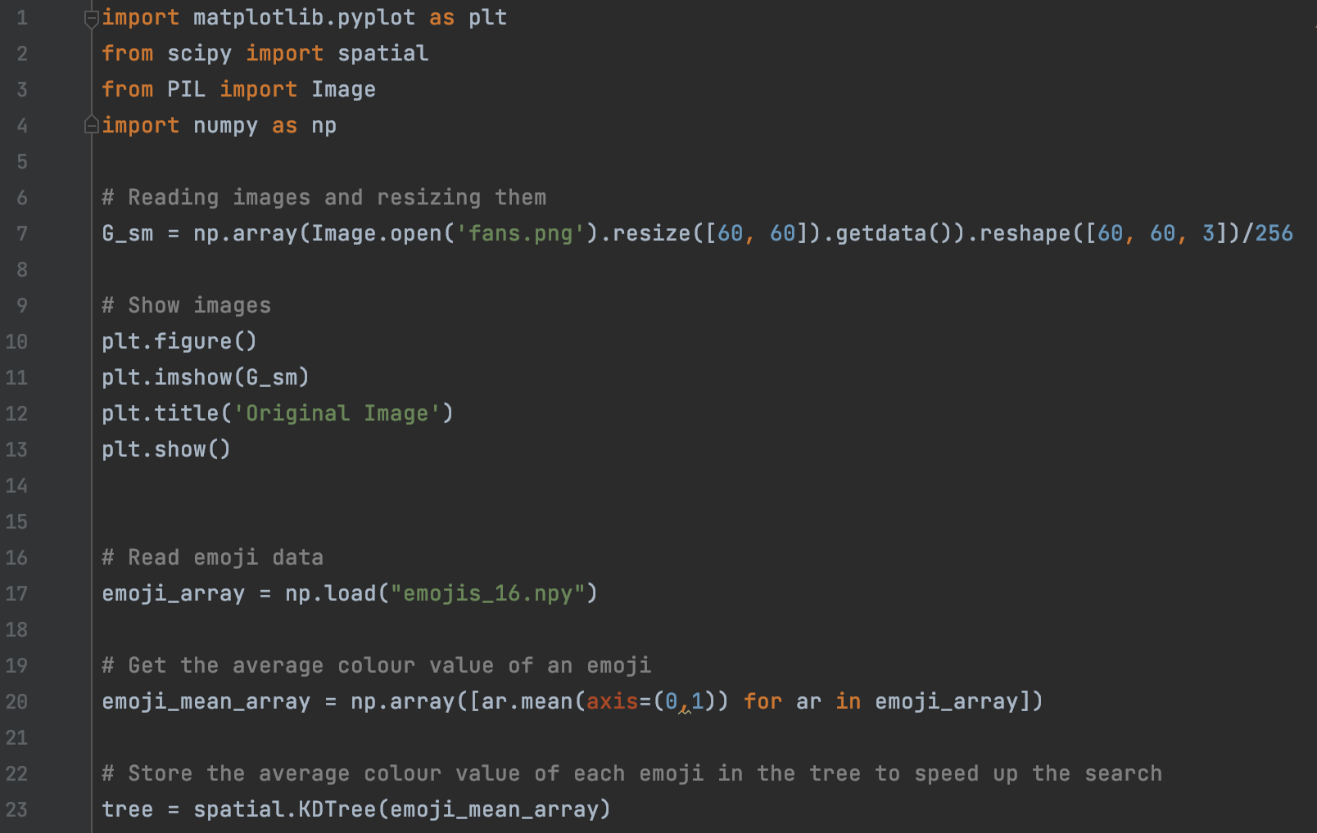
2 CODE
This effect is mainly achieved with three libraries:
matplotlib
pyplot
numpy
For numpy and matplotlib and almost all image processing libraries, an image is basically just a matrix (for example A) in which each pixel is an element of A. In the case of a grey-scale image, each pixel is just a number (or scalar). If it is a floating-point number, it is [0, 1]. If it is an integer, it is [0, 255]. If it is not a grey level (such as this image chosen for this occasion), each pixel is a vector of size 3 - red, green and blue, or size 4 - RGBA (the A stands for Alpha, which indicates transparency).

Slide 4
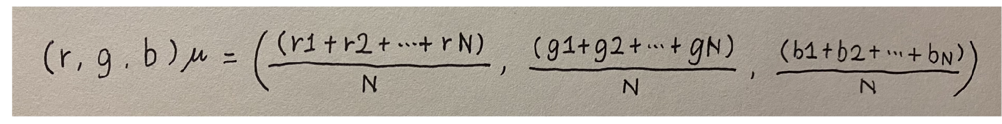
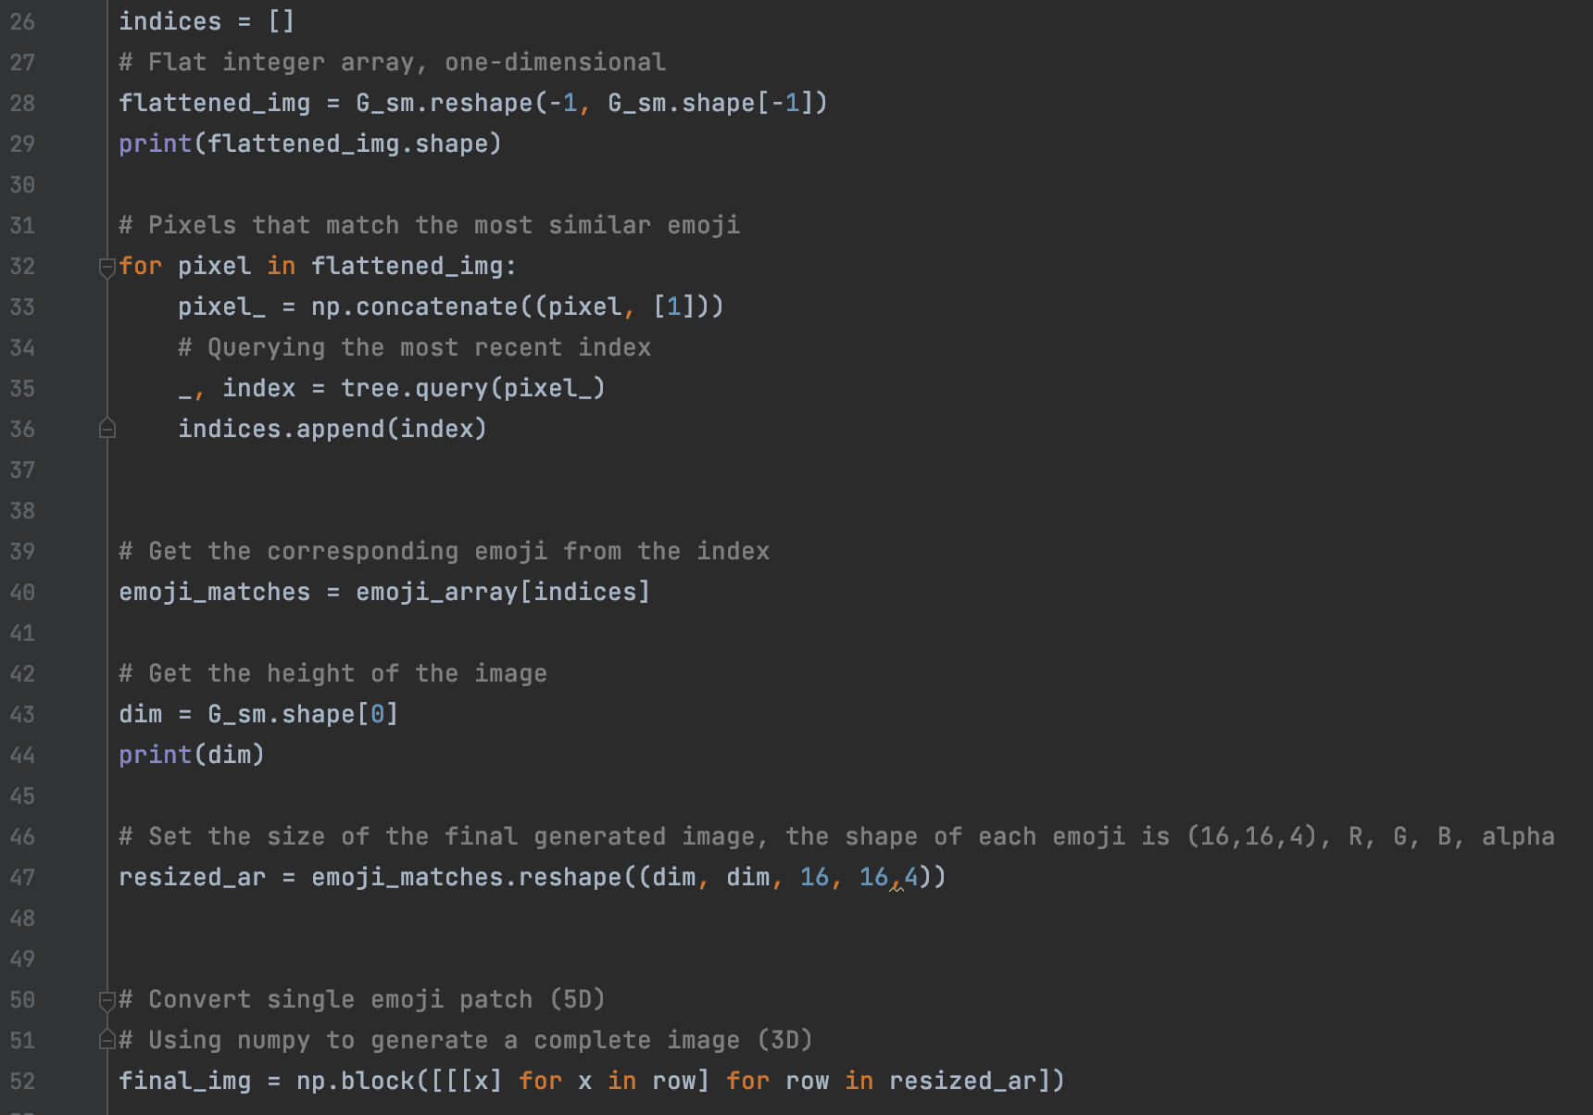
2 CODE
Formula for calculating the average colour of an image
np.load, a function that reads data from a disk array, which is usually stored in uncompressed raw binary format in a file with the extension .npy.

Slide 5
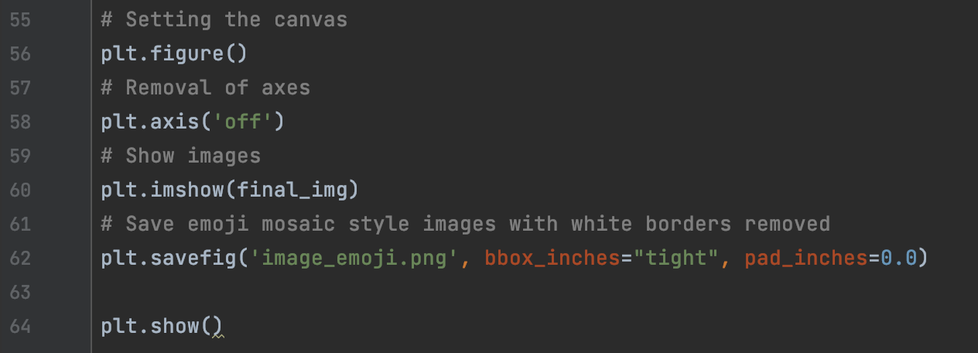
2 CODE
Finally, remove the white border of the image by setting the parameters of plt.savefig. Save the image.

Slide 6
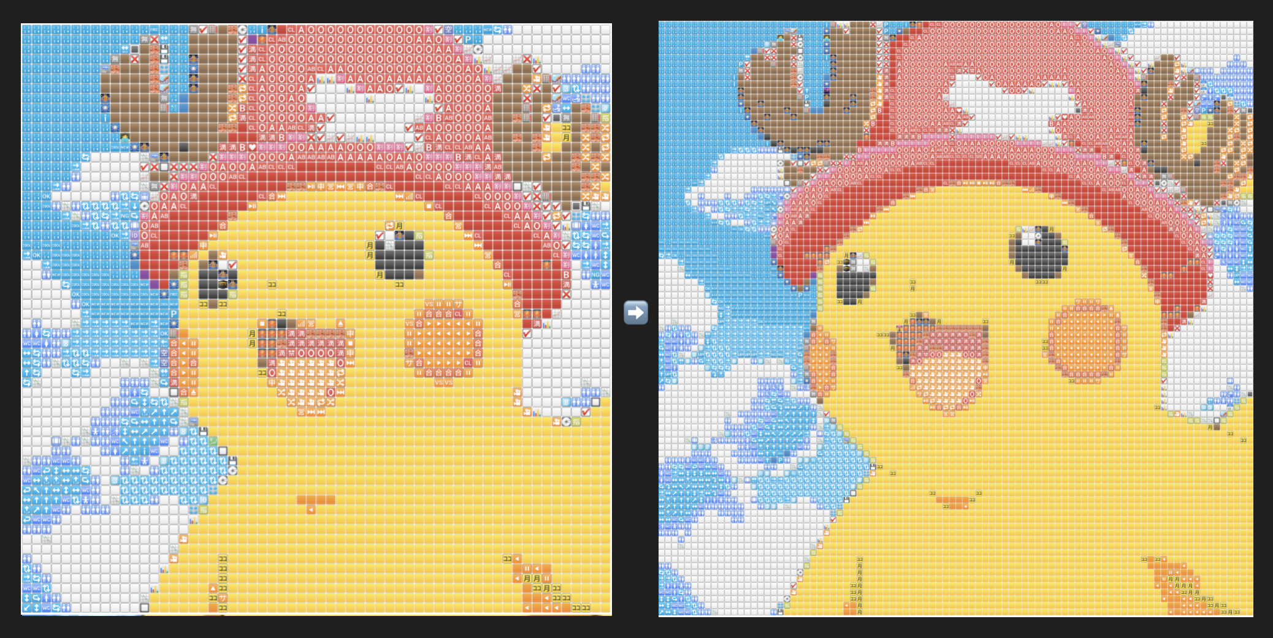
3 problems
If you feel that the resulting emoji image is not detailed enough, you can turn up the image parameters
⬇️
Image comparison

Slide 7
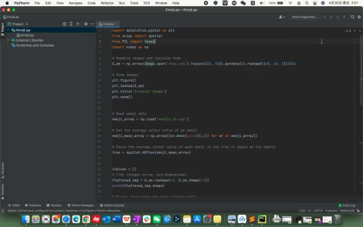

Slide 8
Thanks for your time!

